Slide 1
Java Basics
Introduction to Classes, Objects and Methods

Slide 2
Disclaimer
Document Name:
Data Classification: INTERNAL
Disclaimer
The contents of this document are property of Softtek, and are classified as Confidential. Any reproduction in whole or in part is strictly prohibited without the written permission of Softtek.
This document is subject to change. Comments, corrections or questions should be directed to the author.
Audience/Viewership | Purpose
Java Beginners | Training
Revision Chart
The following chart list the revisions made to this document. Use this to describe the changes and additions each time this document is re-published. The description should be detailed as possible and include the names of the reviewers who request the changes.
Version No. | Version Date | Types of Changes | Owner/Author | Date of Review/Expiration
1 | 2015/07/23 | Creation | Luis Robles | NA

Slide 3
Lesson 3: Introduction to Classes, Objects and Methods

Slide 4
Objects
An object can be considered a "thing" that can perform a set of related activities.
The set of activities that the object performs defines the object's behavior.
For example, the Hand (object) can grip something, or a Student (object) can give their name or address.
If you compare the software object with a real world object, they have very similar characteristics
Software objects also have a state and behavior.
A software object's state is stored in fields and behavior is shown via methods.
So in software development, methods operate on the internal state of an object and the object-to-object communication is done via methods.

Slide 5
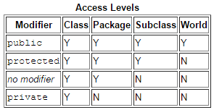
Classes
A class provides methods in order to handle its behavior:
Constructors
Methods.
Controlling Access to Members of a Class
A class can be defined as a template/blue print that describes the behaviors/states that object of its type support
A class can contain any of the following variable types.
Local variables.
Instance variables.
Class variables.
Notes:
A class can contain any of the following variable types.
Local variables: Variables defined inside methods, constructors or blocks are called local variables. The variable will be declared and initialized within the method and the variable will be destroyed when the method has completed.
Instance variables: Instance variables are variables within a class but outside any method. These variables are instantiated when the class is loaded. Instance variables can be accessed from inside any method, constructor or blocks of that particular class.
Class variables: Class variables are variables declared with in a class, outside any method, with the static keyword.
-----
Controlling Access to Members of a Class
Top level:
public
package-private (no explicit modifier)
Member level:
public
private
protected
package-private (no explicit modiifer)

Slide 6
Primitive data types
byte: The byte data type is an 8-bit signed two's complement integer. It has a minimum value of -128 and a maximum value of 127 (inclusive).
short: The short data type is a 16-bit signed two's complement integer. It has a minimum value of -32,768 and a maximum value of 32,767 (inclusive).
int: By default, the int data type is a 32-bit signed two's complement integer, which has a minimum value of -231 and a maximum value of 231-1.
long: The long data type is a 64-bit two's complement integer.
The signed long has a minimum value of -263 and a maximum value of 263-1.
float: The float data type is a single-precision 32-bit IEEE 754 floating point.
double: The double data type is a double-precision 64-bit IEEE 754 floating point.

Slide 7
Primitive data types (cont.)
boolean: The boolean data type has only two possible values: true and false. This data type represents one bit of information, but its "size" isn't something that's precisely defined.
char: The char data type is a single 16-bit Unicode character. It has a minimum value of '\u0000' (or 0) and a maximum value of '\uffff' (or 65,535 inclusive).
String: The String class is not technically a primitive data type.
The Java programming language also provides special support for character strings via the java.lang.String class.
String objects are immutable, which means that once created, their values cannot be changed

Slide 8
Common structure Java Class
Standalone Java Application
Define restricted access to its properties (Data Encapsulation)
Provide public getter/setter to access its properties
Provide public methods to handle the behavior
public static void main(String[] args)
Java Component
Define restricted access to its properties (Data Encapsulation)
Provide public getter/setter to access its properties
Provide public methods to handle the behavior

Slide 9
Packages
A package is a grouping of related types providing access protection and name space management
A package is a namespace that organizes a set of related classes and interfaces.
Conceptually you can think of packages as being similar to different folders on your computer.
Packages are nothing more than the way we organize files into different directories according to their functionality
We can use control access implicit “package” to all artifacts inside to a specific package
Notes:
Definition: A package is a grouping of related types providing access protection and name space management. Note that types refers to classes, interfaces, enumerations, and annotation types. Enumerations and annotation types are special kinds of classes and interfaces, respectively, so types are often referred to in this lesson simply as classes and interfaces.
Share benefits about to use correctly Packages inside to Enterprise solution.

Slide 10
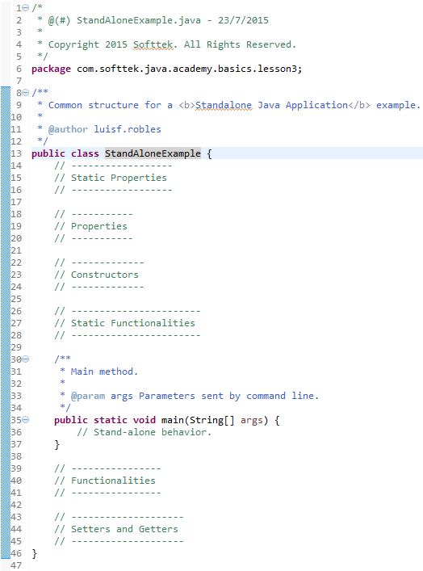
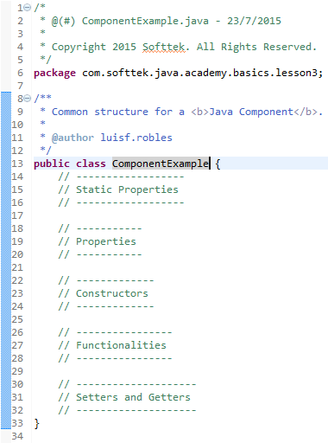
Common structure
Standalone application
Component

Slide 11
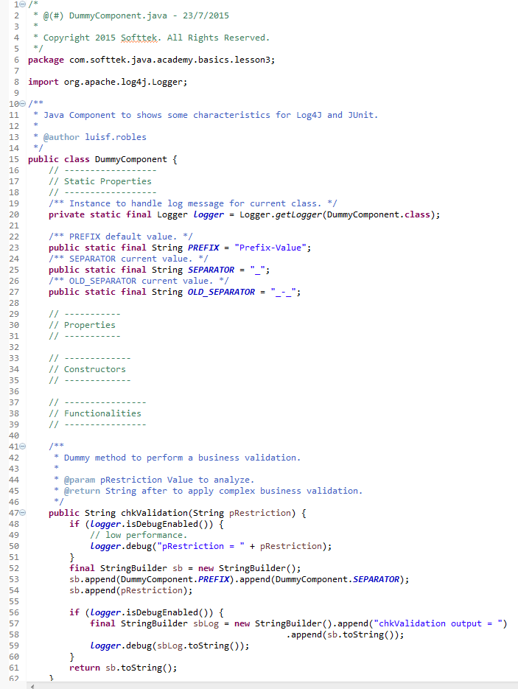
Common frameworks and Best Practices
Log4J: It is used to have runtime information in log files about execution of the application.
JUnit: provides a way to craft Unit Testing for each artifact.
System.out.println() vs Log4J
Concat Strings using “+” vs StringBuilder class
JavaDoc and comments: Write code to be read by others.
Notes:
Share best practices to use Log4J instead of System.out.println() to write messages in log file.
Share best practices to increase performance using StringBuilder/StringBuffer instead of concat String using operator “+”
Share advantages to use JavaDoc and write comments correctly.

Slide 12
Links and References
https://docs.oracle.com/javase/tutorial/index.html
http://docs.oracle.com/javase/tutorial/java/concepts/class.html
http://docs.oracle.com/javase/tutorial/java/concepts/object.html
http://docs.oracle.com/javase/tutorial/java/concepts/package.html
https://docs.oracle.com/javase/tutorial/java/javaOO/accesscontrol.html
https://docs.oracle.com/javase/tutorial/java/nutsandbolts/datatypes.html
http://www.cavdar.net/2008/07/21/junit-4-in-60-seconds/
http://www.oracle.com/technetwork/articles/java/index-137868.html
http://javarevisited.blogspot.mx/2011/08/code-comments-java-best-practices.html

Slide 14
Luis Robles
luisf.robles@softtek.com
Related to training material (Java Basics module)
Sarahi Flores
sarahi.flores@softtek.com
Instructor

